Slide 1
SALES ANALYSIS USING SQL
MENTORNESS TASK 2
BY V.Akshatha

Slide 2
DATABASE DESCRIPTION
Customers: Contains customer information, including cust_id, first_name, last_name,
email, phone, primary_pincode, gender, dob, joining_date.
Products: Contains product information, including product_id, product_name, brand,
category, procurement_cost_per_unit, mrp.
Pincode: Contains pincode-related information, including the pincode, city and state.
Delivery Person: Contains information about delivery personnel, including delivery_person_id, name, joining_date, pincode
Orders: Contains order details, including order_id, order_type, cust_id, order_date,
delivery_date, tot_units, displayed_selling_price_per_unit, total_amount_paid,
product_id, delivery_person_id, payment_type, delivery_pincode

Slide 3
SOME BASIC COMMANDS INVOLVED….
SELECT
FROM
WHERE
HAVING
AGGREGATION FUNCTIONS
JOINS
NESTED QUERIES / SUB QUERIES
ORDER BY
GROUP BY

Slide 4


SELECT & FROM COMMAND
SELECT retrieves data from one or more tables in a database.
FROM specifies the table from which to retrieve the data in the SELECT statement.
WHERE filters records based on specified conditions.
SELECT & FROM Syntax
WHERE Syntax

Slide 5
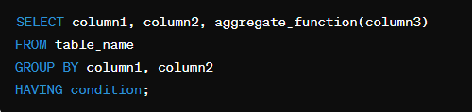
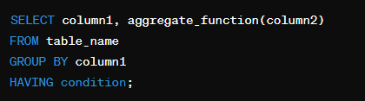
HAVING COMMAND
HAVING filters groups of rows based on specified conditions when using aggregate functions.
Usually used with aggregate functions
Accompanied with GROUP BY of one / more columns

Slide 6
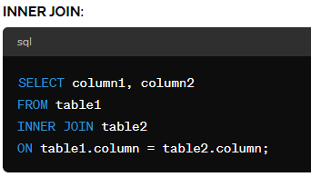
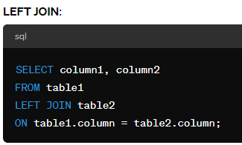
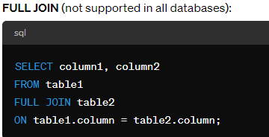
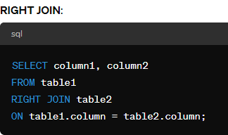
JOINS IN SQL
Joins combines rows from two or more tables based on a related column between them.
Types are INNER , LEFT , RIGHT , FULL OUTER JOINS

Slide 7
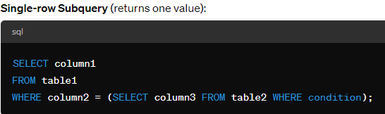
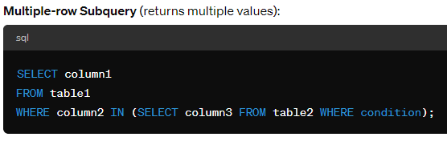
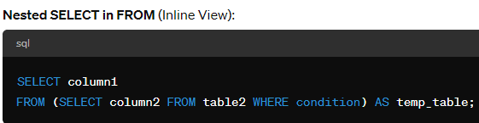
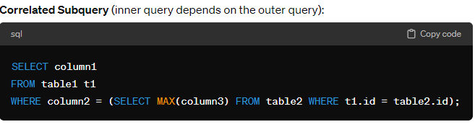
NESTED QUERIES / SUB QUERIES
Nested query / sub query is a query inside another query, used for performing operations based on the result of the inner query.

Slide 8
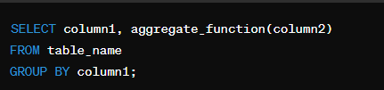

GROUP BY Vs ORDER BY
GROUP BY groups rows that have the same values into summary rows
ORDER BY sorts the result set in ascending or descending order.
GROUP BY Syntax
ORDER BY Syntax

Slide 9
SALES ANALYSIS USING SQL ( SUMMARY OF THE PROJECT )
In this project, we worked with a Sales Database consisting of five key tables: customers, products, pincodes, deliverypersons, and orders. The aim was to extract meaningful insights and perform various levels of analysis using SQL queries.
Various levels of queries like basics , intermediate and advanced were executed and outputs were recorded.
File link of the Code details : https://docs.google.com/document/d/1jrj1fPCJ-hm_mG2bTc3PGuT8XCNI-wfH/edit?usp=drive_link&ouid=110988339681952749139&rtpof=true&sd=true

Slide 10
THANK YOU !!!

